Slide 1
BANKRUPTCY PREVENTION
MENTOR :-
SNEHAL SHINDE
GROUP MEMBERS:-
Hymasree.P
Bhanu Teja
B.Venkateshwara Rao
R Vaishnavi
Gayathrry Sree
Vignesh Kumar R

Slide 2

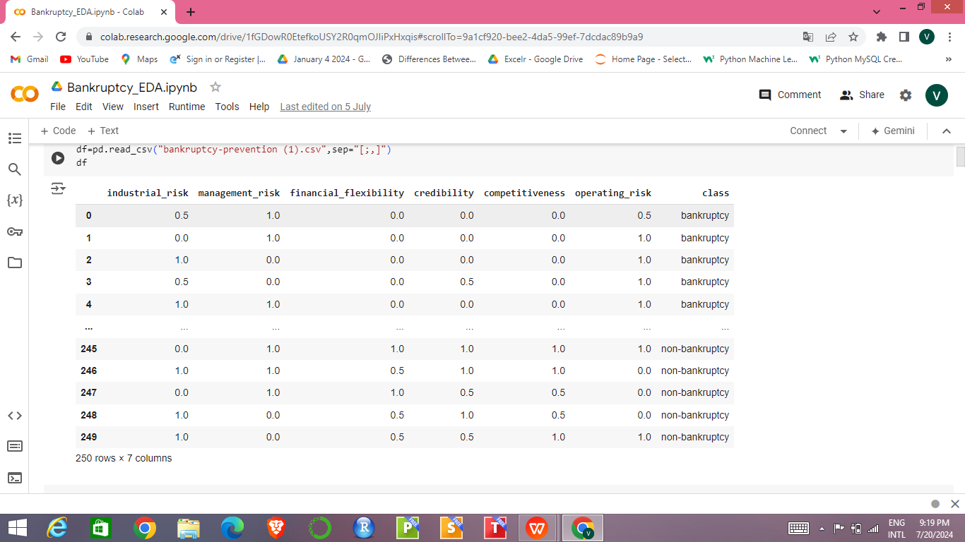
Classification Problem - binary (bankruptcy or non-bankruptcy)
Goal - model the probability that a business goes bankrupt from different features.
The dataset contains 7 features about 250 companies.

Slide 3
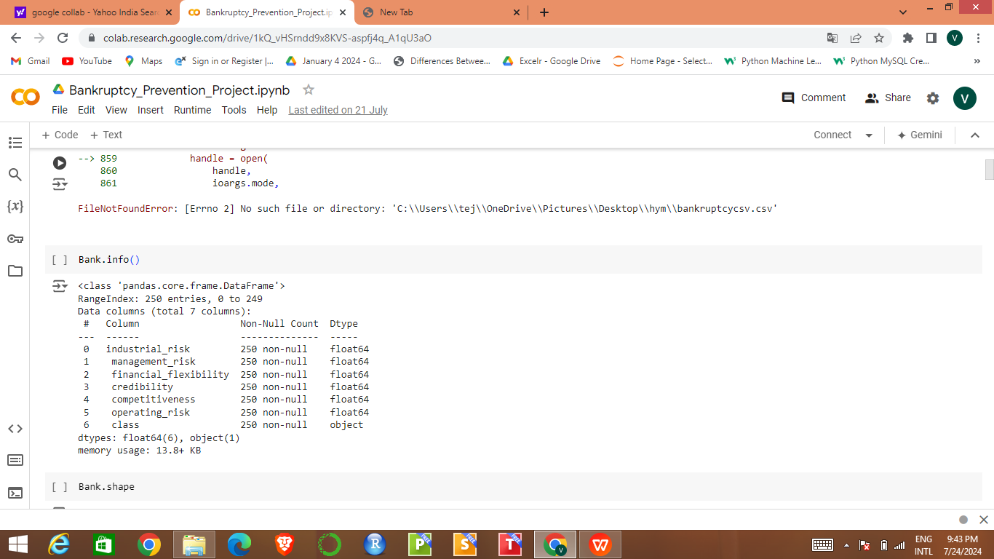
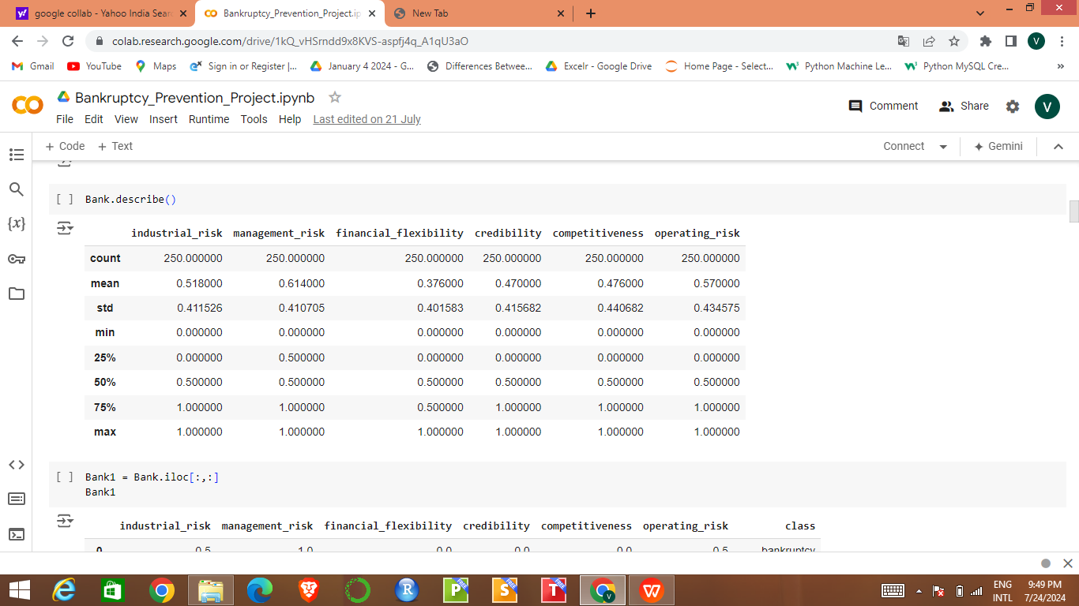
Exploratory Data Analysis (EDA)
Data Understanding :-
Summary Statistics :-

Slide 4
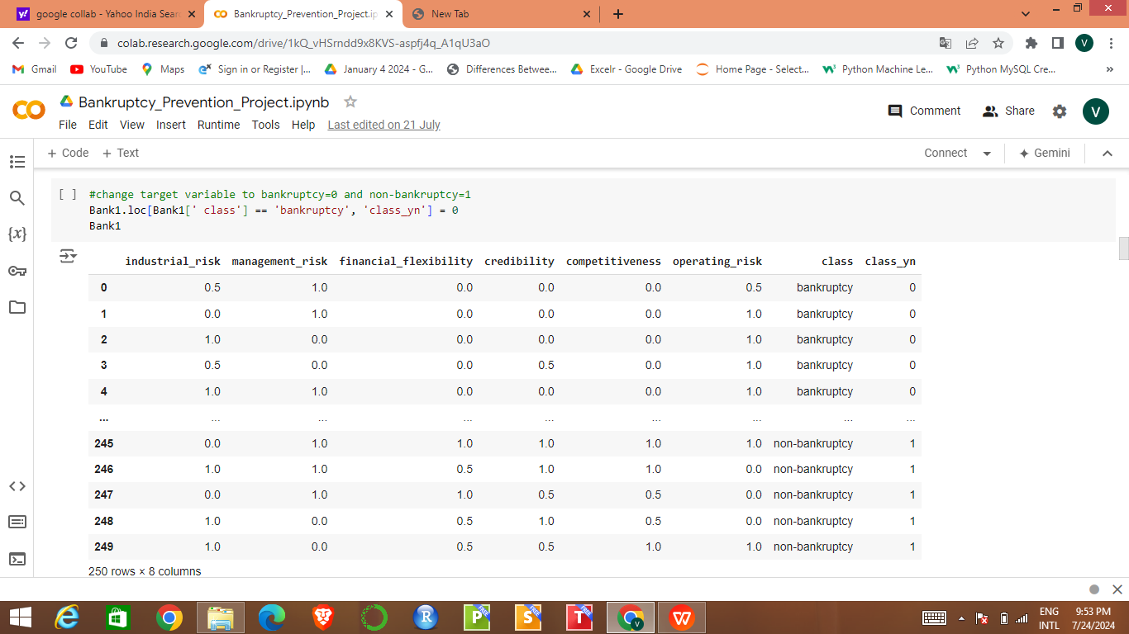
Handling missing values
Handling Duplicates
Added the column “class_yn” making it as target variable instead of the “class” column . It gives the values “0” to bankruptcy and “1” to non-bankruptcy.
Dropped the “class” column of object data type.

Slide 5
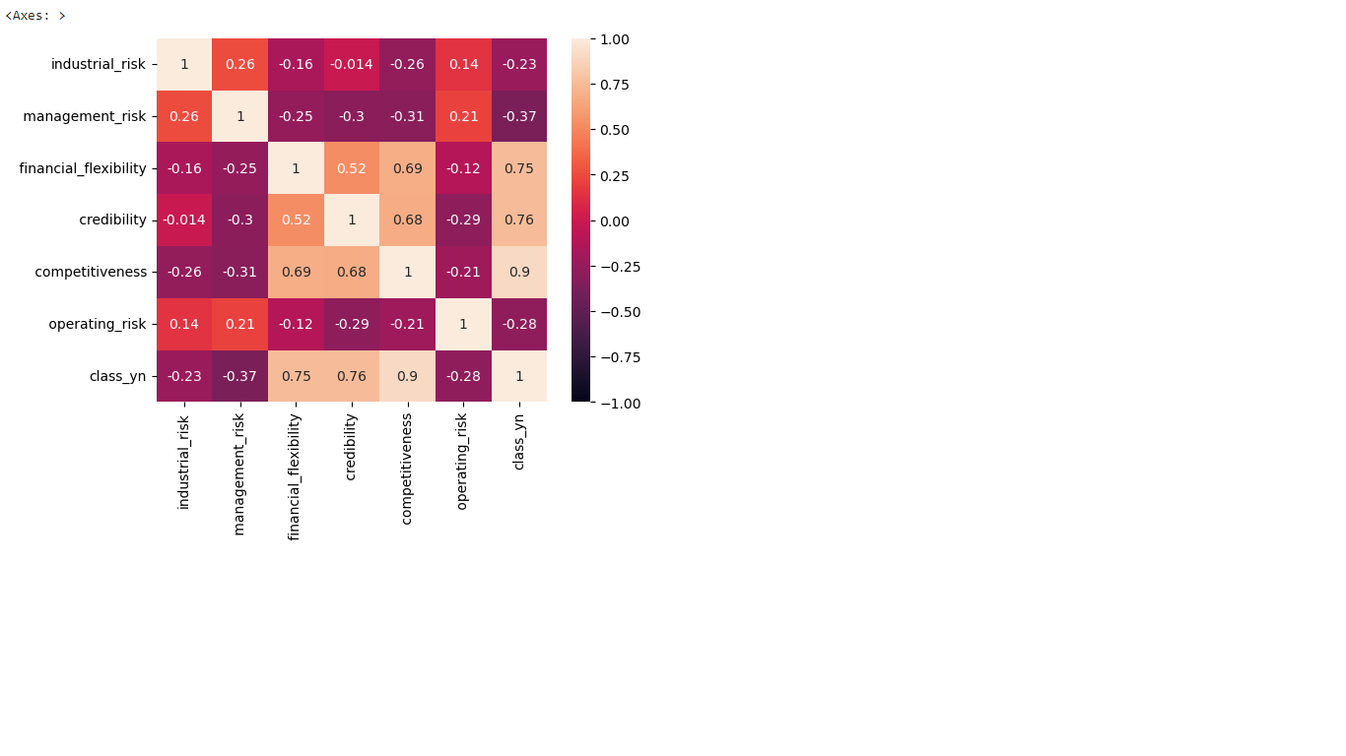
Data Visualization
Heat Map :

Slide 6
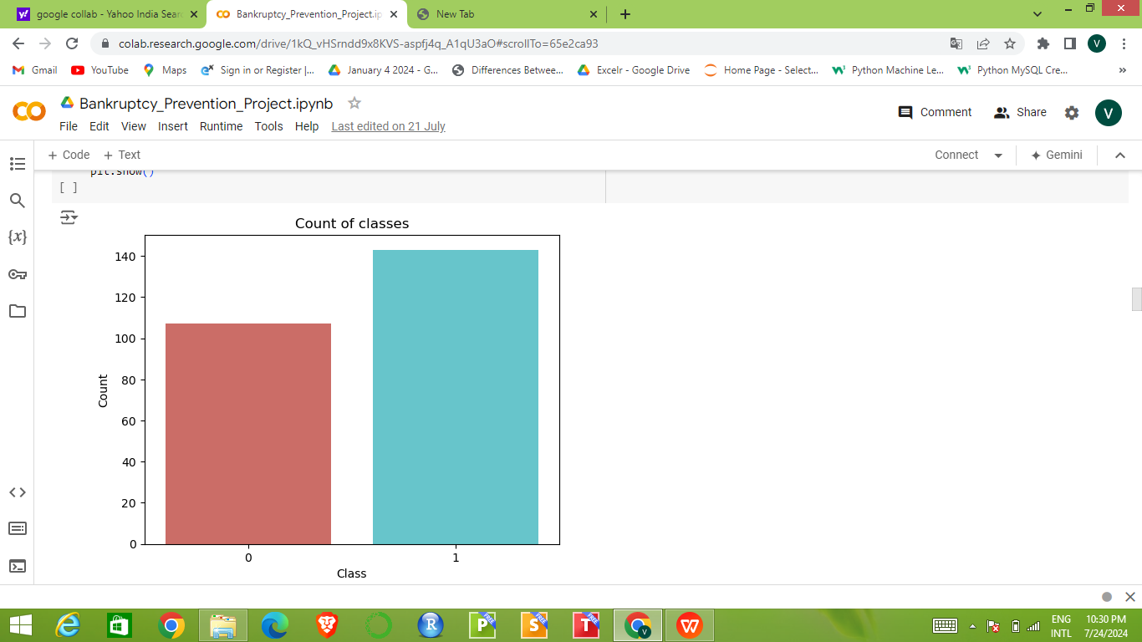
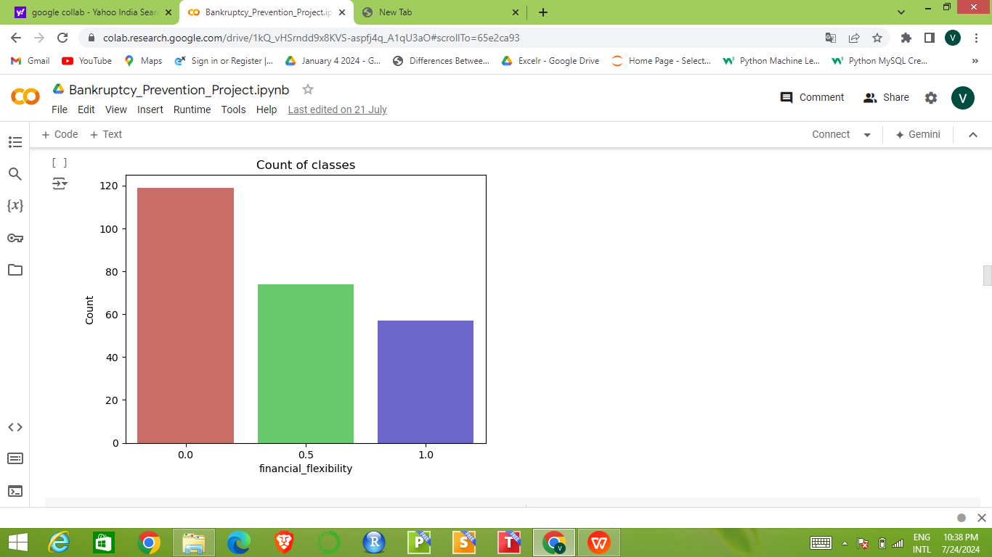
Count plot (class_yn) :
Count plot (financial_flexibility) :

Slide 7
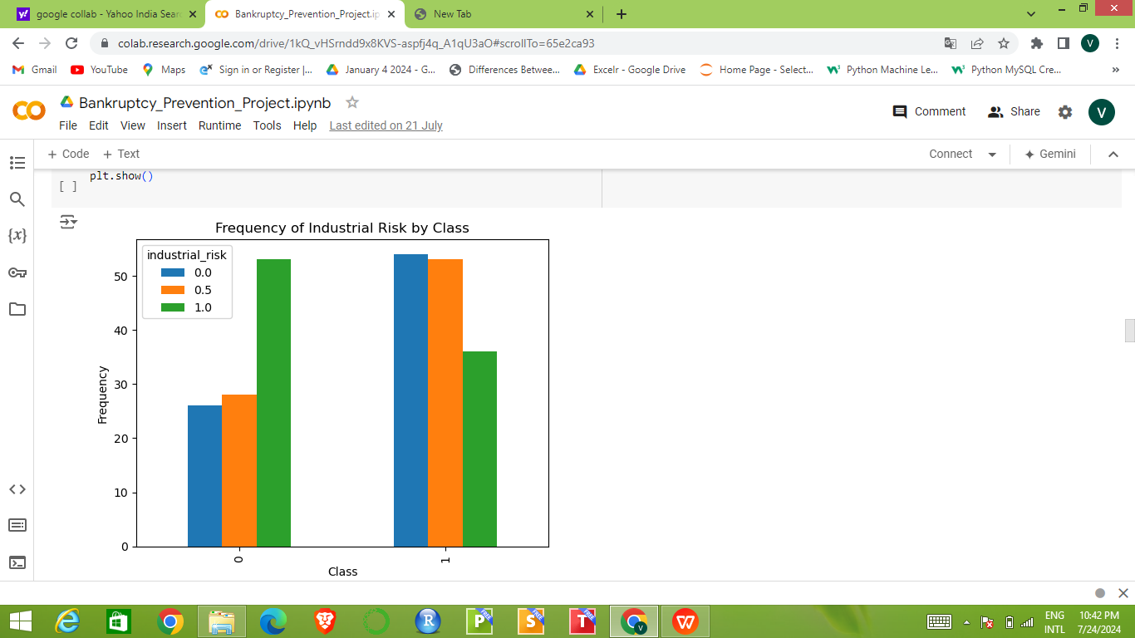
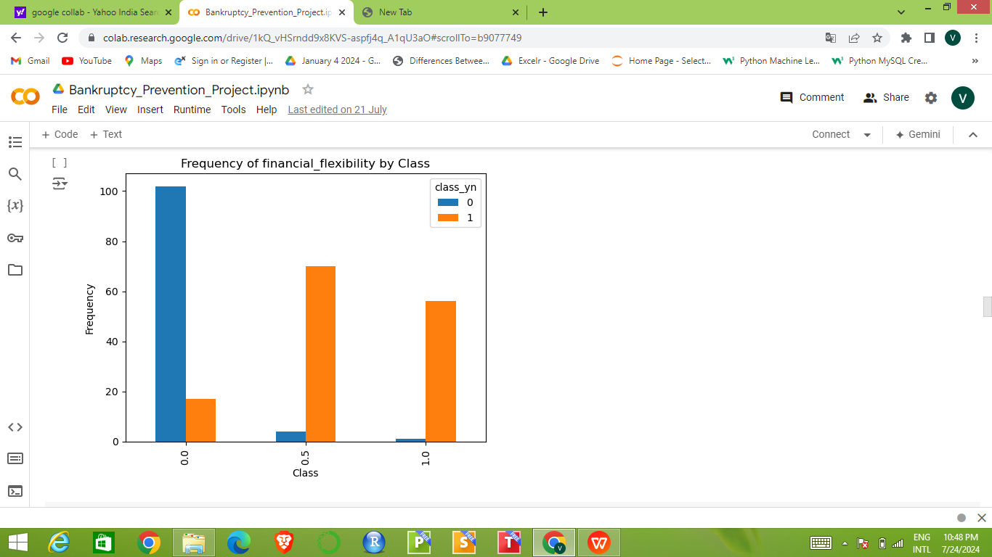
Frequency of Industrial Risk by Class (Bar plot) :
Frequency of financial_flexibility by Class (Bar Plot) :

Slide 8
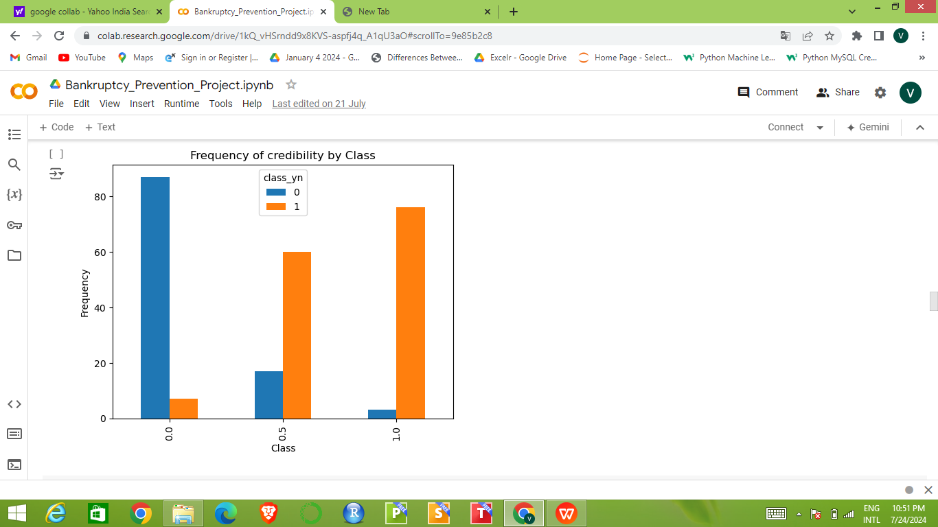
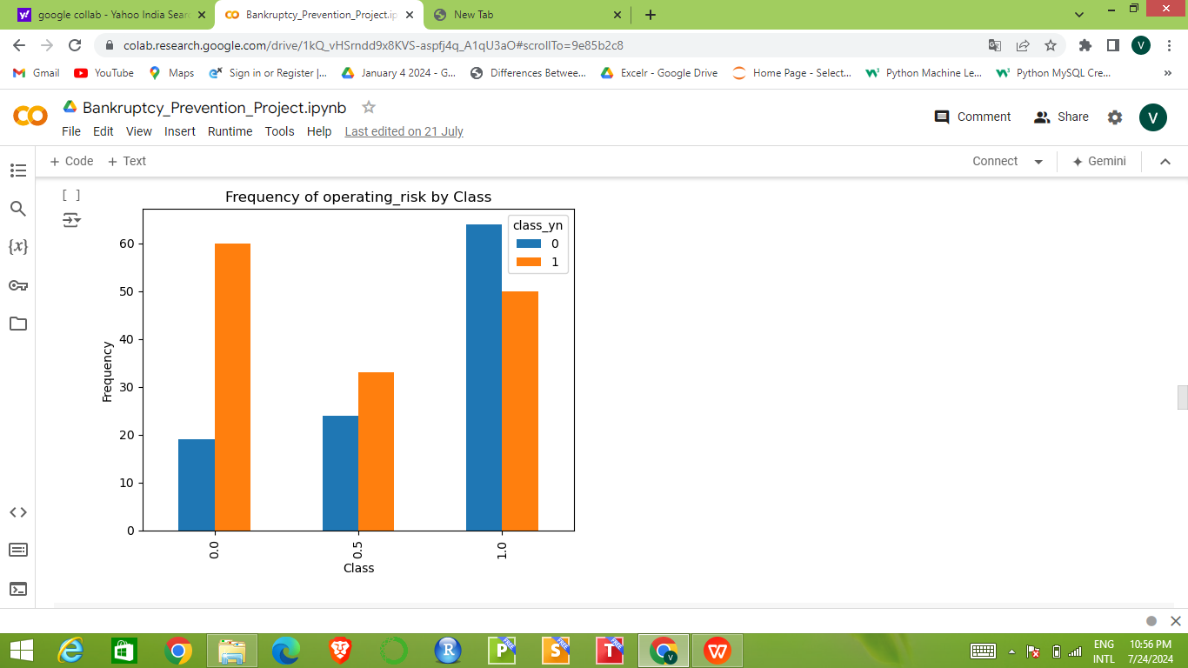
Frequency of credibility by Class (Bar plot) :
Frequency of operating_risk by Class (Bar plot) :

Slide 9
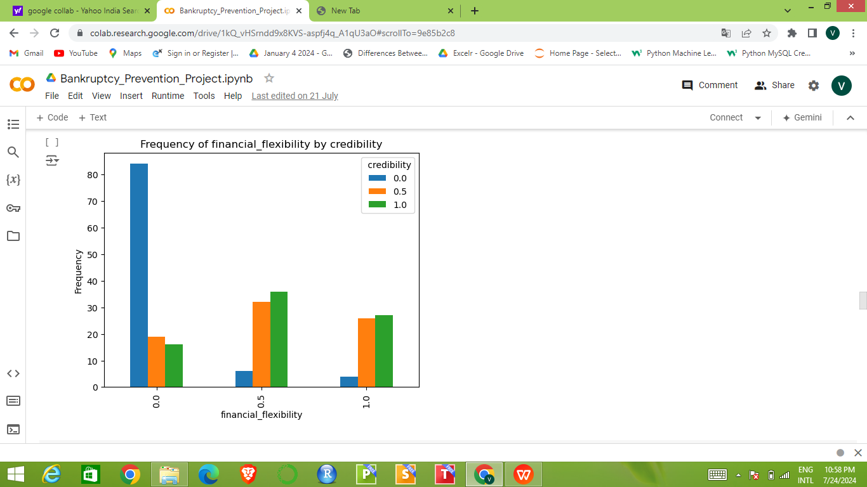
Frequency of financial_flexibility by credibility (Bar Plot) :

Slide 10
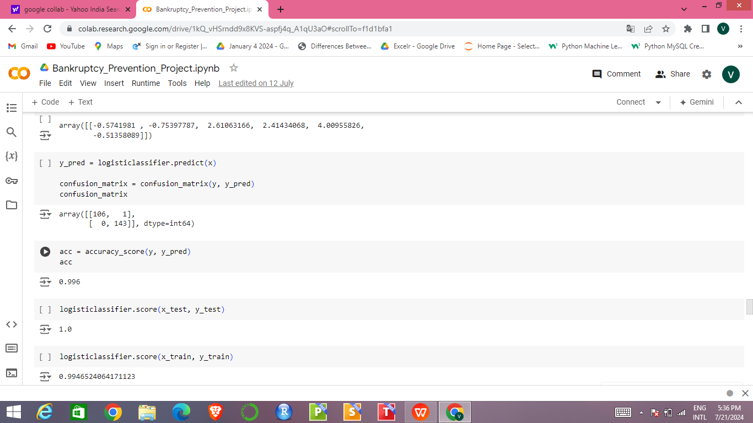
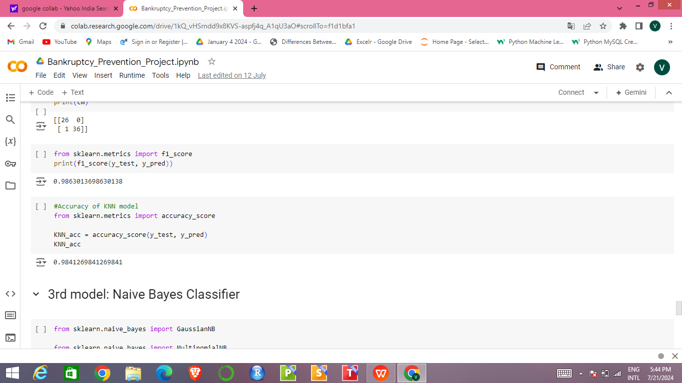
Model Building
Separate the input variables (x) and Target variables (y) .
Splitting the dataset into train and test sets. (75 -25 split respectively) .
Preparing models
Logistic Regression :
2. KNN ( K - Nearest Neighbors ) :

Slide 11
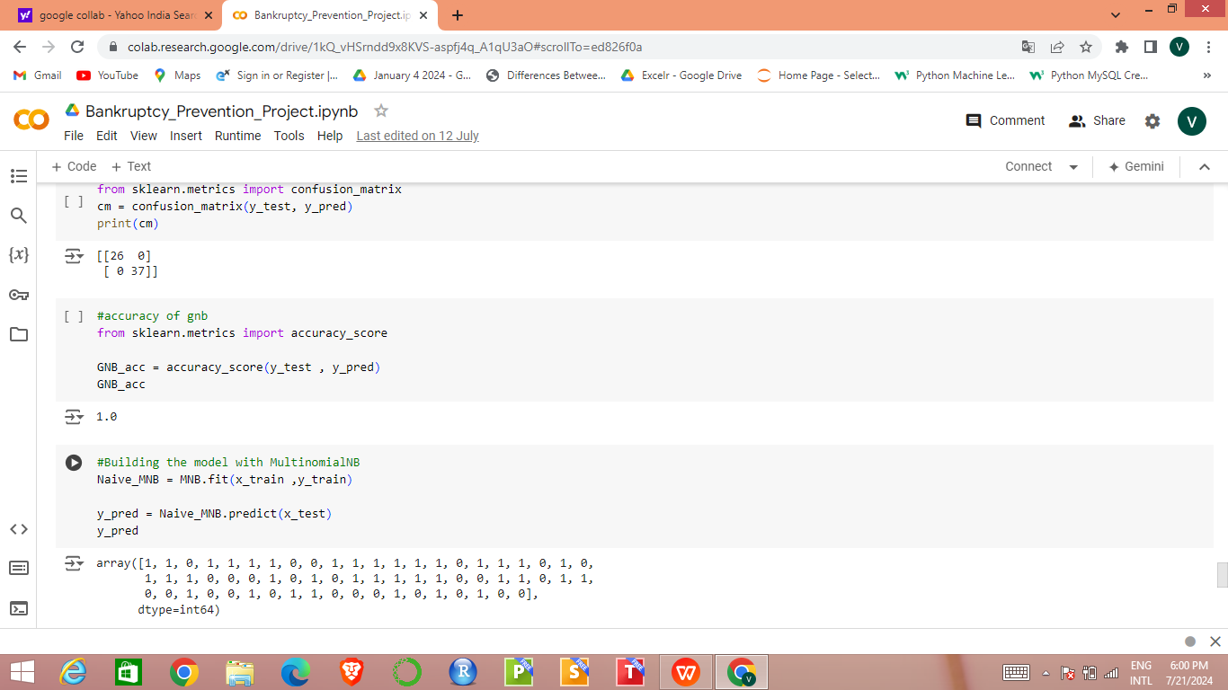
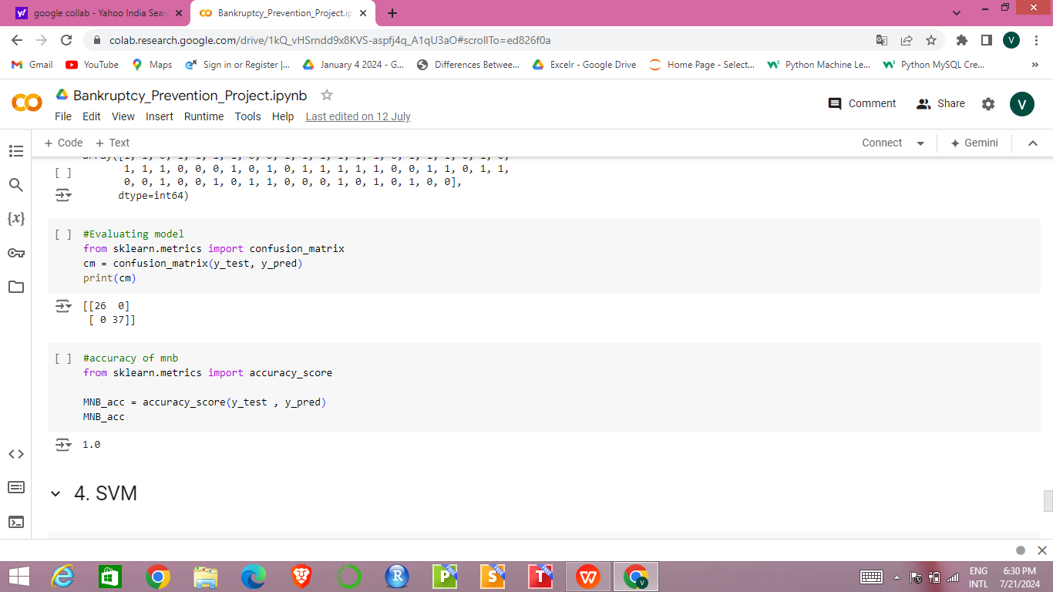
3. Naive Bayes Classifier :
Gaussian Naive Bayes :
Multinomial Naive Bayes :

Slide 12
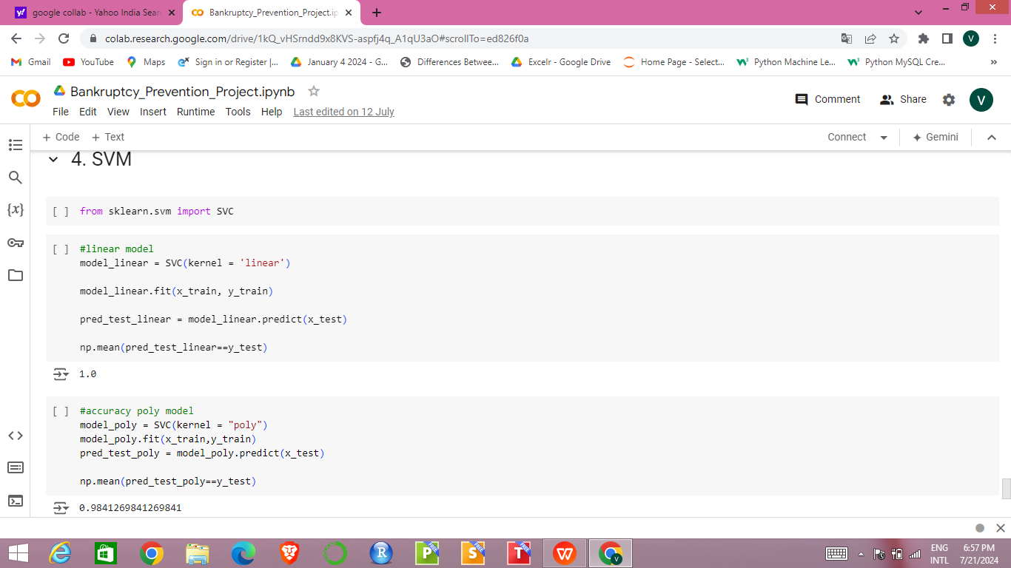
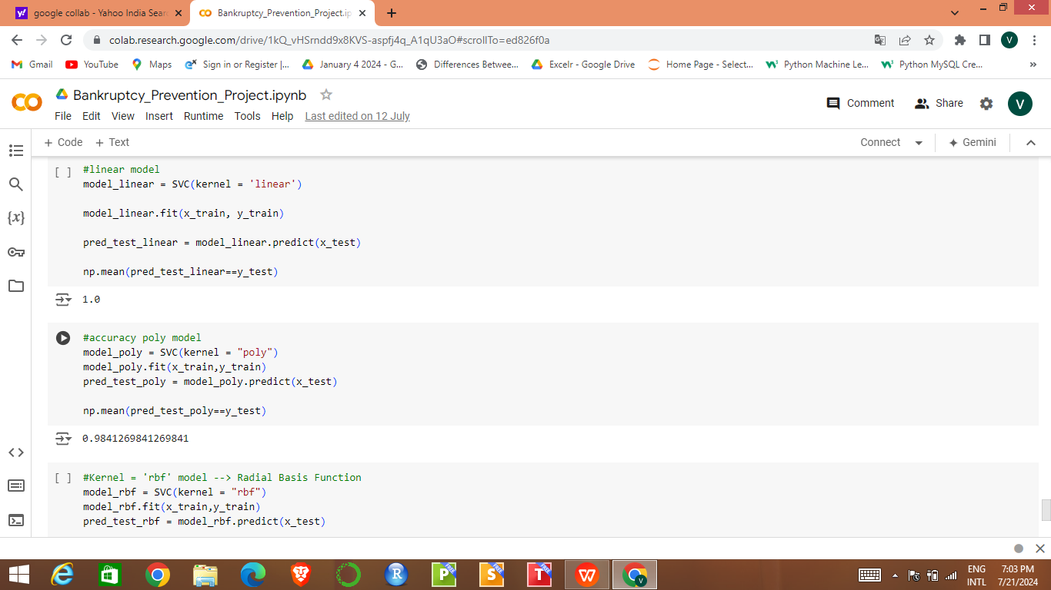
4. Support Vector Machine (SVM) :
Linear Kernel :
Polynomial Kernel :

Slide 13
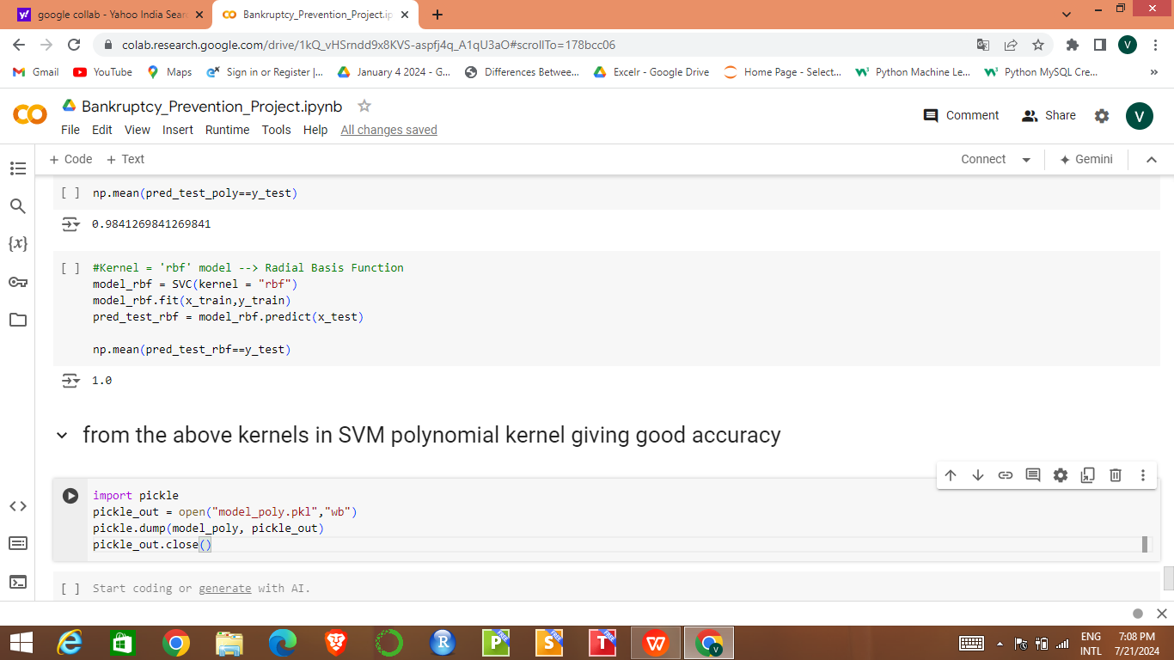
Radial Basis Function :

Slide 14
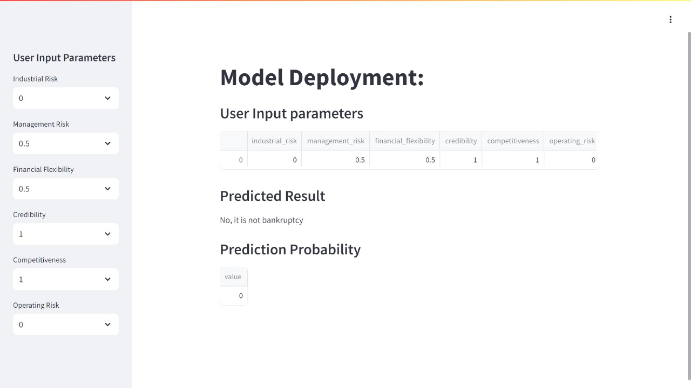
Model Deployment
SVM Polynomial kernel model is selected for Deployment process. (Streamlit)

Slide 15
We need to give the values for User Input Parameters as : 0 (low risk) or 0.5 (medium risk) or 1 (high risk) according to our requirement .
So, we will get the predicted result (Yes , it is bankruptcy/ No , it is not bankruptcy) and prediction probability according to the given values.

Slide 16
THANK YOU

